Slide 1
Representation of trade and transportation networks in global energy models Updates: 2019-07-04
Jun Ukita Shepard
IIASA-YSSP 2019

Slide 2
Updates
Run MESSAGE with oil exports and imports parameterized
Allow landlocked regions to only trade via pipeline with neighboring regions
Begin adding shipping technology

Slide 3
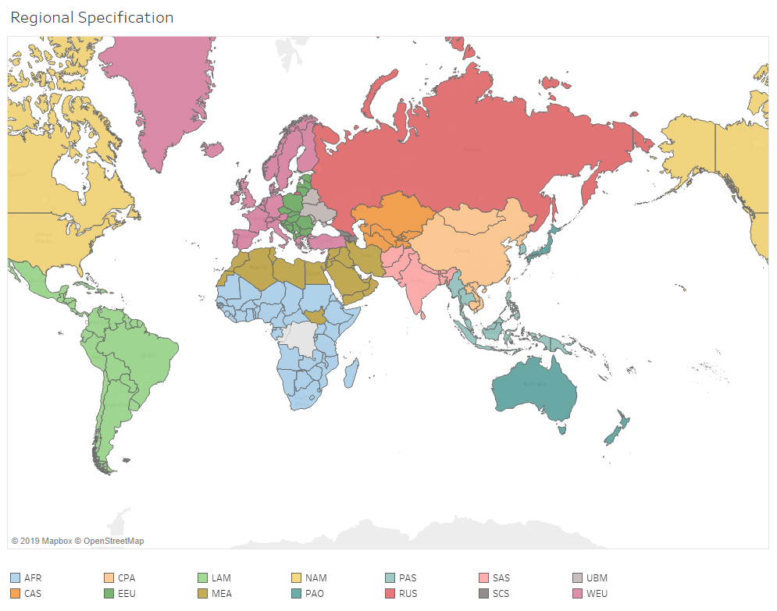
Regional specification

Slide 4
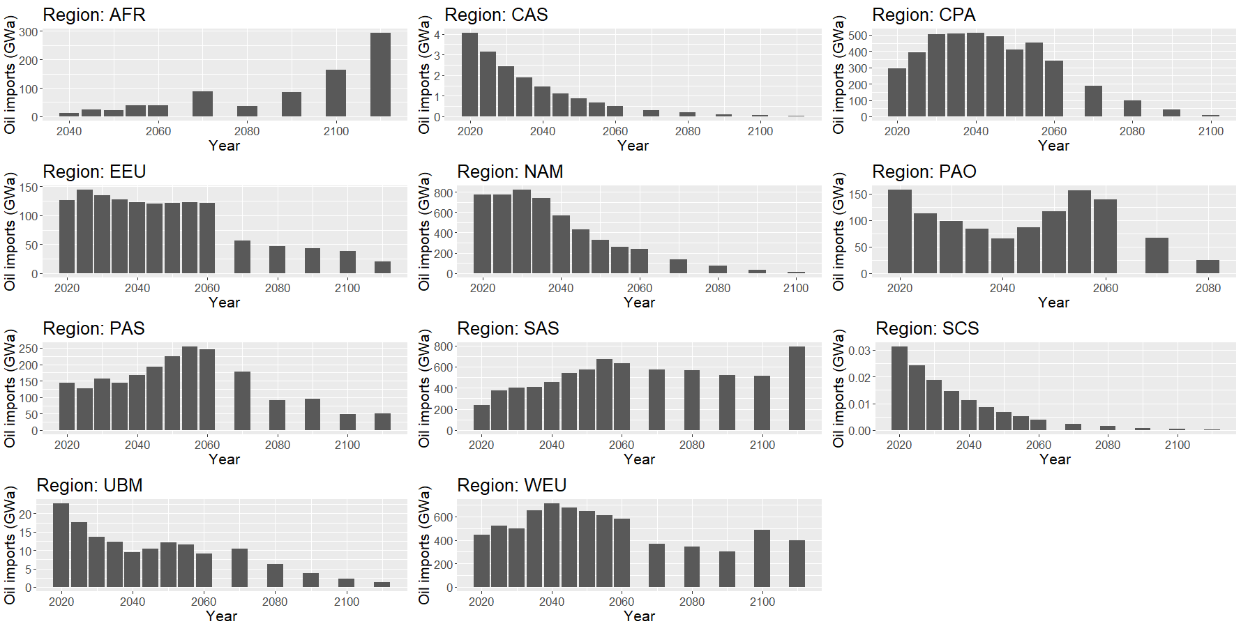
Compare global and bilateral schema Global: oil imports

Slide 5
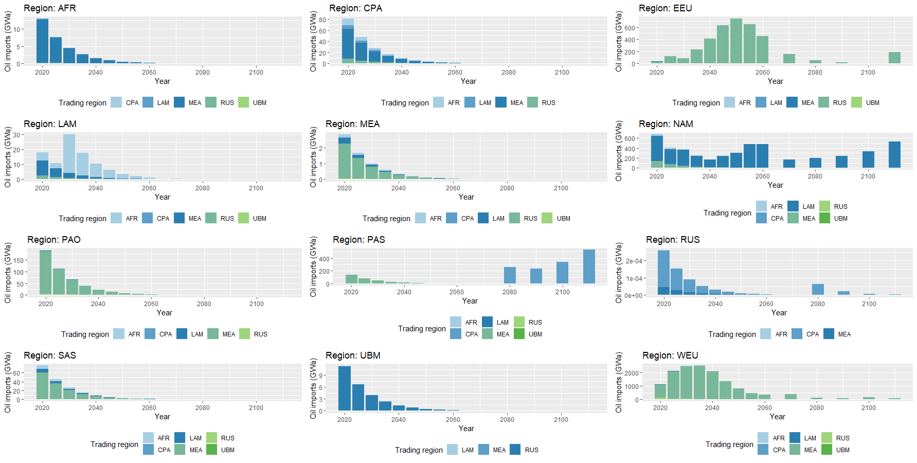
Compare global and bilateral schema Bilateral: oil imports (no costs)

Slide 6
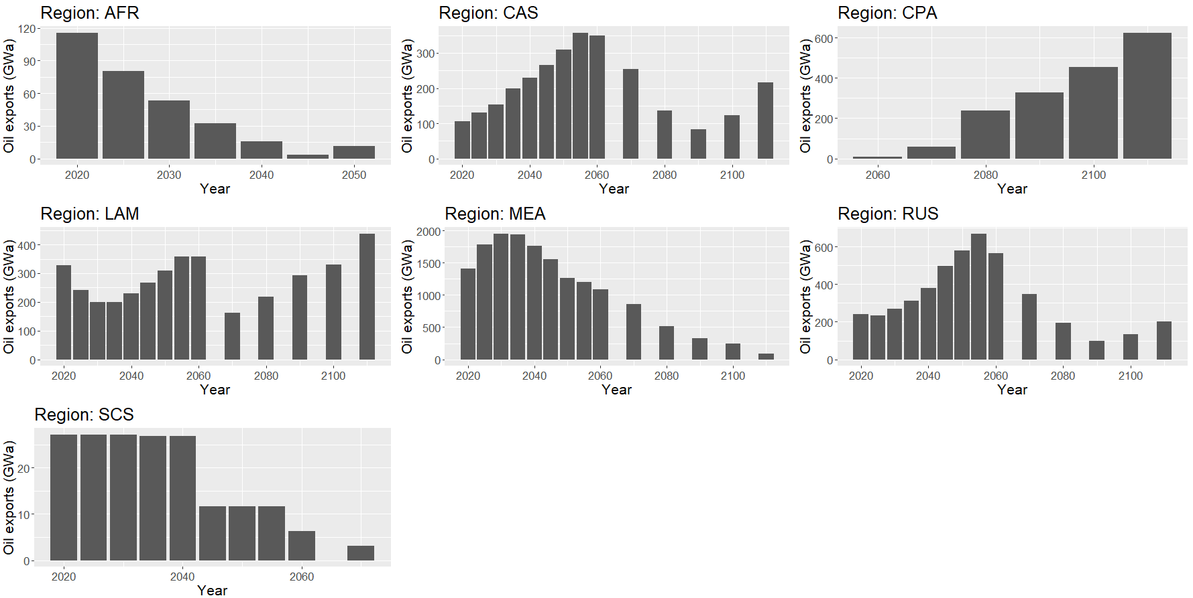
Compare global and bilateral schema Global: oil exports

Slide 7
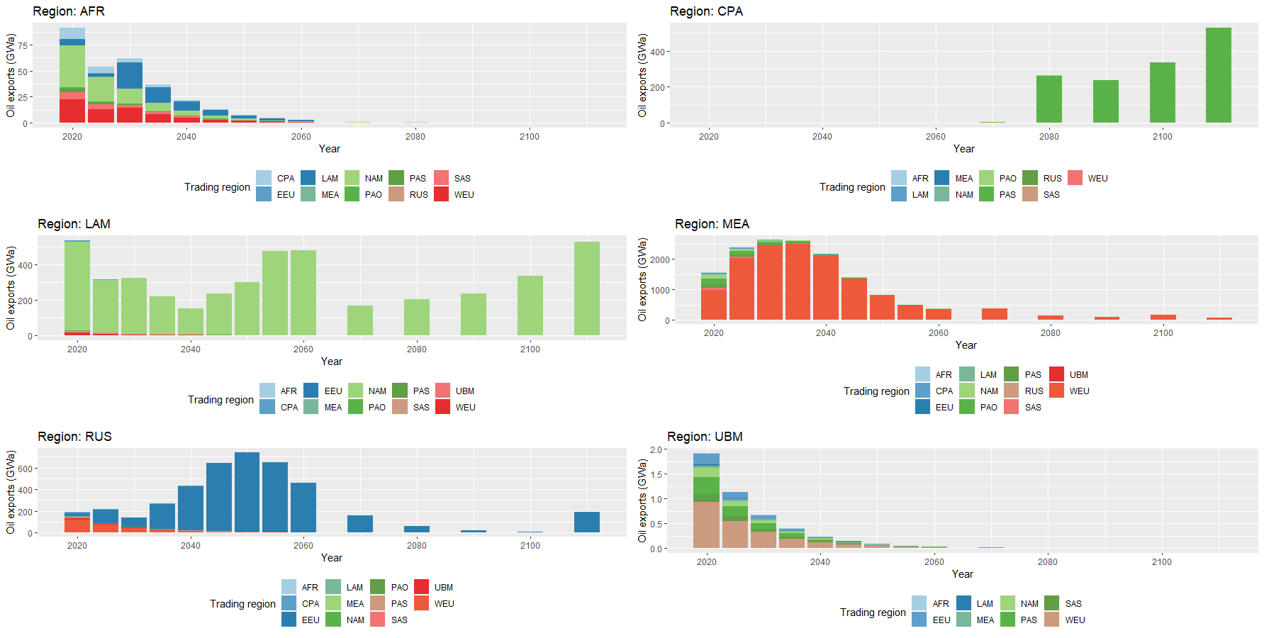
Compare global and bilateral schema Bilateral: oil exports

Slide 8
Add shipping technology Parameters to include
capacity_factor
emission_factor
fix_cost
historical_activity
historical_new_capacity
input
inv_cost
relation_activity
technical_lifetime
var_cost

Slide 9
Add shipping technology Disaggregating UNCTAD data
UNCTAD has global historical activity in billion tonnes-km (2000-2018)
UNCTAD has activity in million tonnes disaggregated by region for 2006-2017
Take share of region activity in million tonnes to disaggregate global historical activity

Slide 10
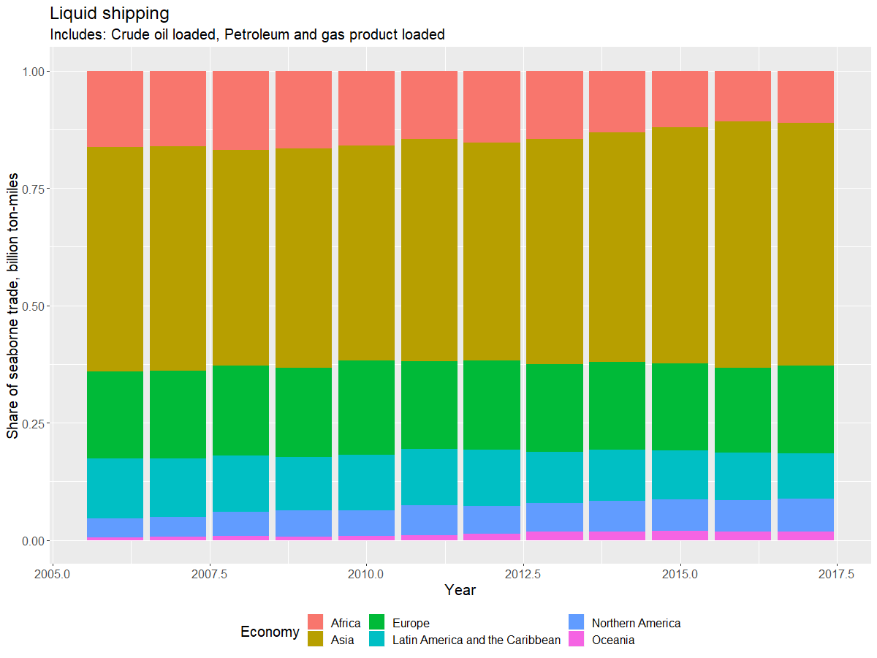
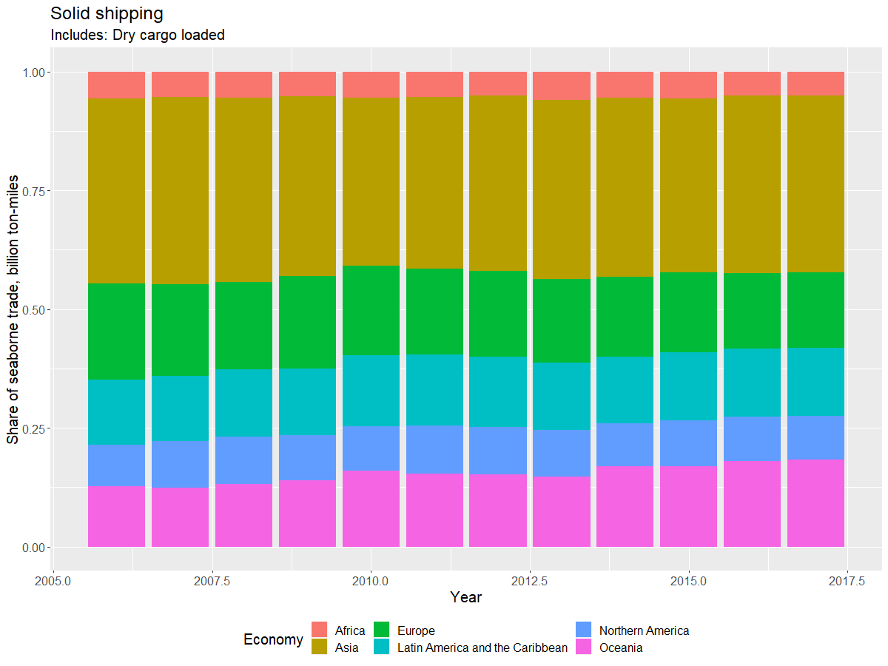
Add shipping technology Disaggregating UNCTAD data

Slide 11
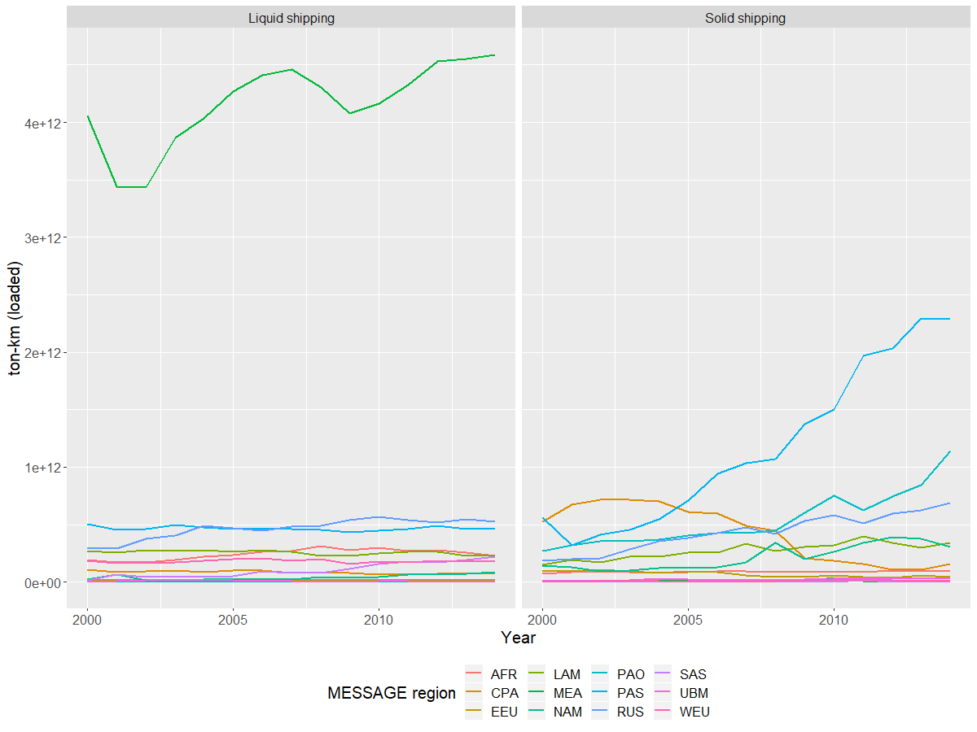
Add shipping technology UNCTAD data → historical_activity parameter

Slide 12
Representing trade in MESSAGE “Global Pool” schema
PRIMARY
GP1
GP2
GP3
EXPORT
EXPORT/IMPORT
SECONDARY
crudeoil
crudeoil
crudeoil
crudeoil
crudeoil
crudeoil
AFR
Input
oil_exp
Output
GLB
GLB
Input
oil_trd
Output
GLB
GLB
Input
oil_imp
Output
NAM
node_loc
node_loc
node_loc
AFR
GLB
NAM
Legend:
Level (e.g. primary)
Node (e.g. R14_RUS)
Commodity (e.g. crude oil)
Technology (e.g. oil_exp)
Parameter (e.g. input)

Slide 13
Representing shipping in MESSAGE Global pool of shipping capacity
SECONDARY
EXPORT
fueloil
liquid_shipping_capacity
AFR
Input
liquid_shipping
Output
GLB
node_loc
AFR
Legend:
Level (e.g. primary)
Node (e.g. R14_RUS)
Commodity (e.g. crude oil)
Technology (e.g. oil_exp)
Parameter (e.g. input)

Slide 14
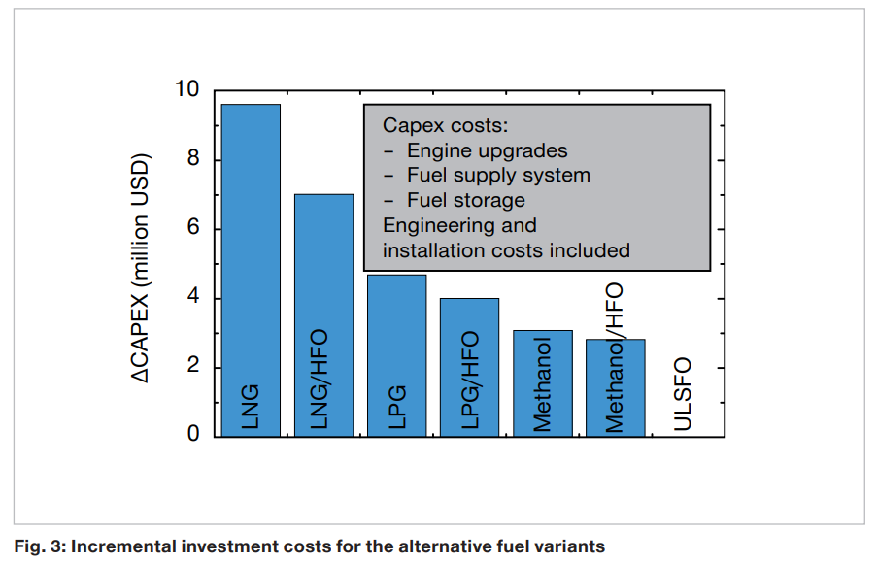
Investment costs of shipping technologies Differences based on fuel
Source: MAN Energy Solutions (link)

